Slide 1
AMI
Create AMI from Instance
Setup AMI in other region

Slide 2
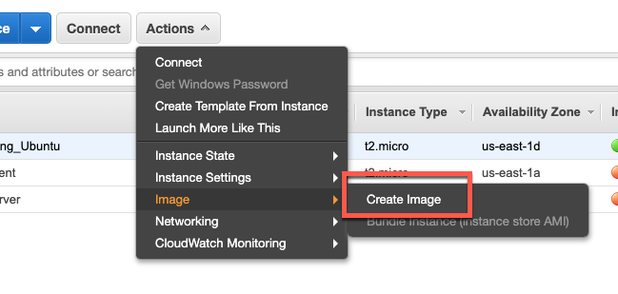
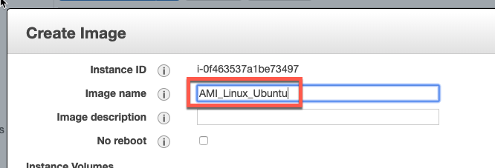
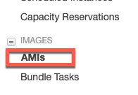
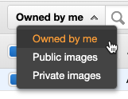
Create an AMI
Select the instance (which we launched – ubuntu))
Click on Actions->Image>Create Image
In the Create Image dialog box, enter an unique Image Name and click on Create Image button
Click on Close button for the notification window
It may take a few minutes for the AMI to be created. After it is created, it will appear in the AMIs view in AWS Explorer.
Click on the dropdown and select “Owned by me”

Slide 3
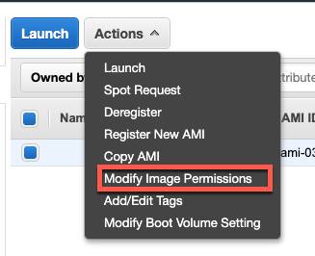
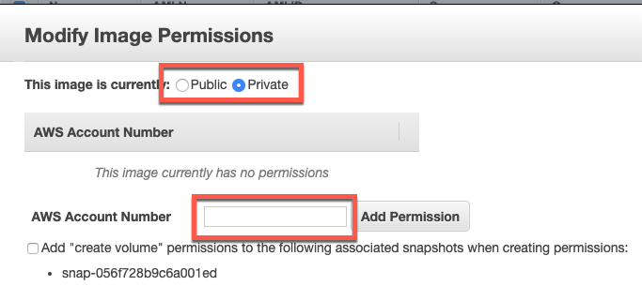
Change AMI permissions
Select the Image
Click on Actions->Modify Image Permissions
Click on Public radio button
OR
Enter AWS Account number of participant and click on Add Permission button
Click on Save button

Slide 4

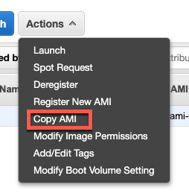
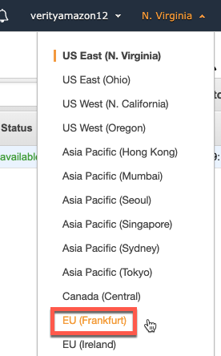
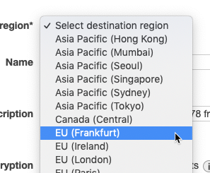
Setup AMI in other region
Ensure region is set as N. Virginia
Click on Actions->Copy AMI
In Destination Region Select EU (Frankfurt)
Click on COPY AMI button
Click on Done button for the confirmation window
Change region to EU(Frankfurt)
We would see our image
The image may take several minutes (while working in free tier) for the status to ready

Slide 5
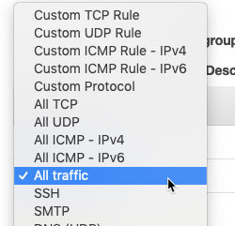

Launch the AMI
While still staying in Region - EU - Frankfurt
Select the image and click on Launch
Click on Next – Configure Instance Details
Click on Next – Add Storage
Click on Next – Add Tags
Click on Next – Configure Security Group
Click on Add Rule
Select All Traffic
In Custom, enter 0.0.0.0/0
Click on Review and Launch
Click on Launch
Create a Key Pair

